Slide 1


Titolo presentazione sottotitolo
House Sales in King County, WA
A nonparametric approach
Milano, XX mese 20XX
Sartor, Panzeri, Mugheddu, Usubelli

Slide 2
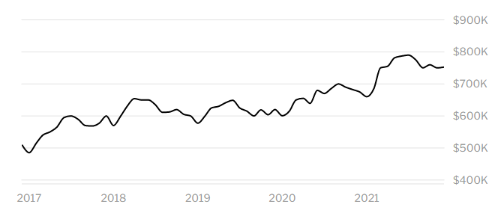


Problem
Median House Sale Price in King County
Median Sale Price
$ 755,000
+11.7% year-over-year
How much is it worth paying for the house I dream?
Seattle downtown seen from Queen Anne Hill
Notes:
Have you ever thought about buying a house?
What characteristics should it have?
What impact does the first impression have?
Have you ever suspected that the price was too high?

Slide 3

Procedure
Preprocessing – Outlier Detection
Test relevant features
Model house prices
Diagnostics – Model Improvement

Slide 4

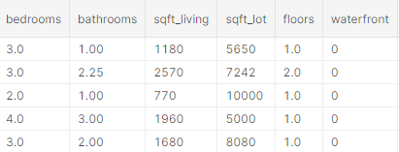

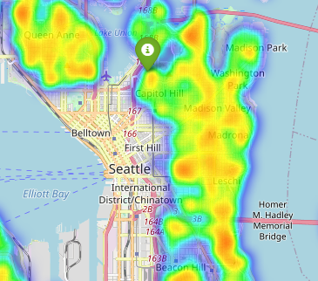
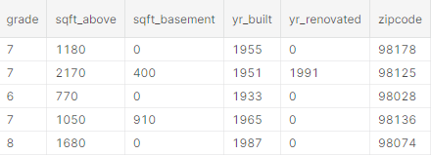
Dataset
Sale prices
21k houses
New variables:
geodist_index
has_ren
is_rich
King County (WA)
Seattle, WA

Slide 5
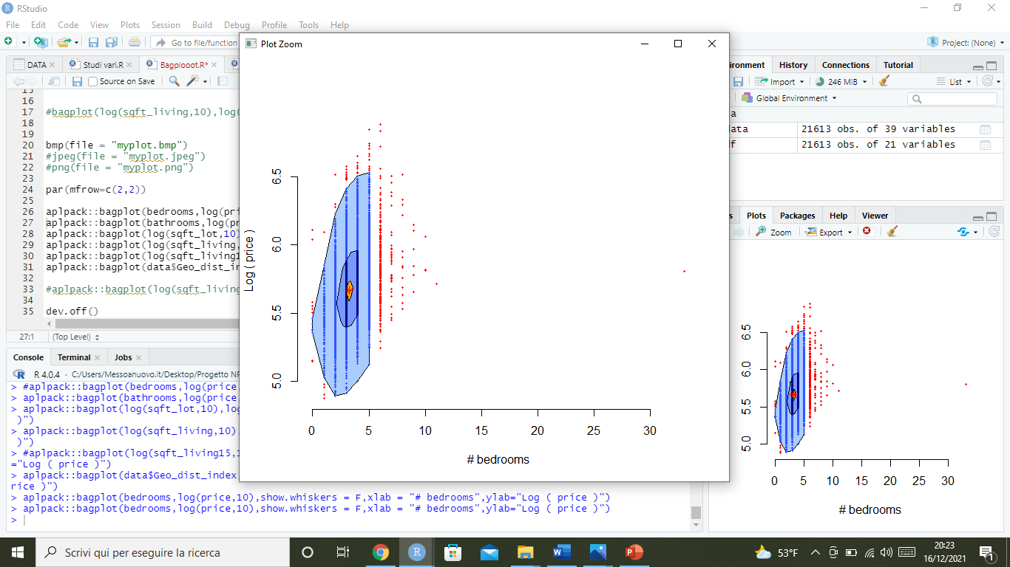
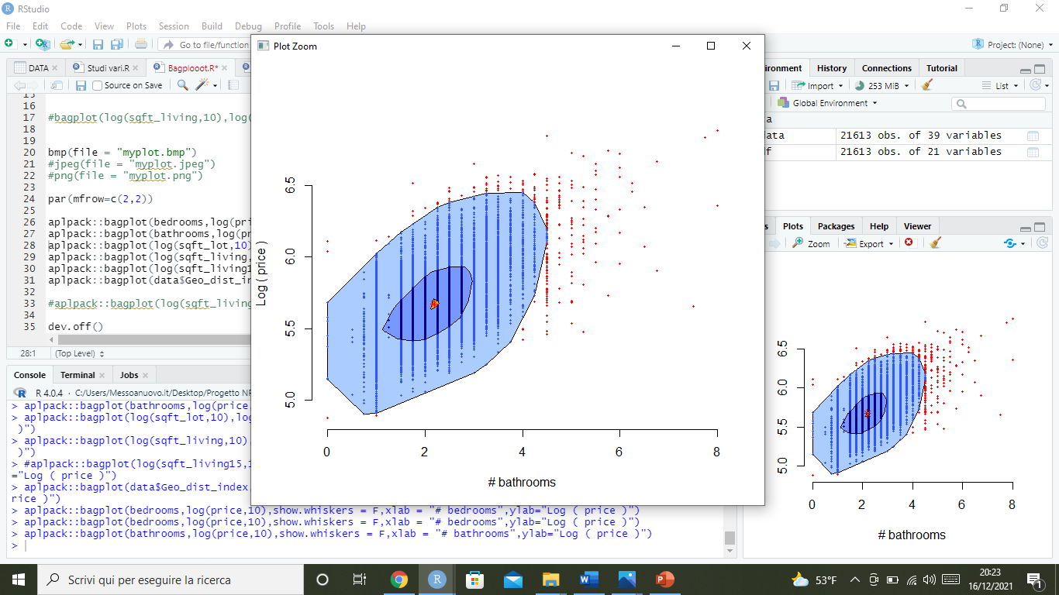
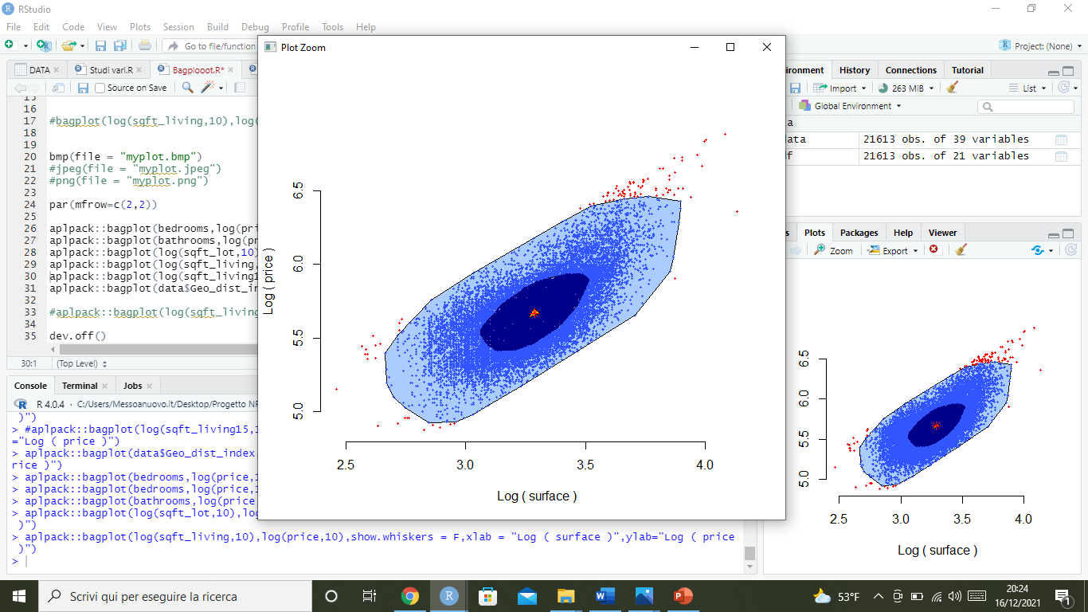
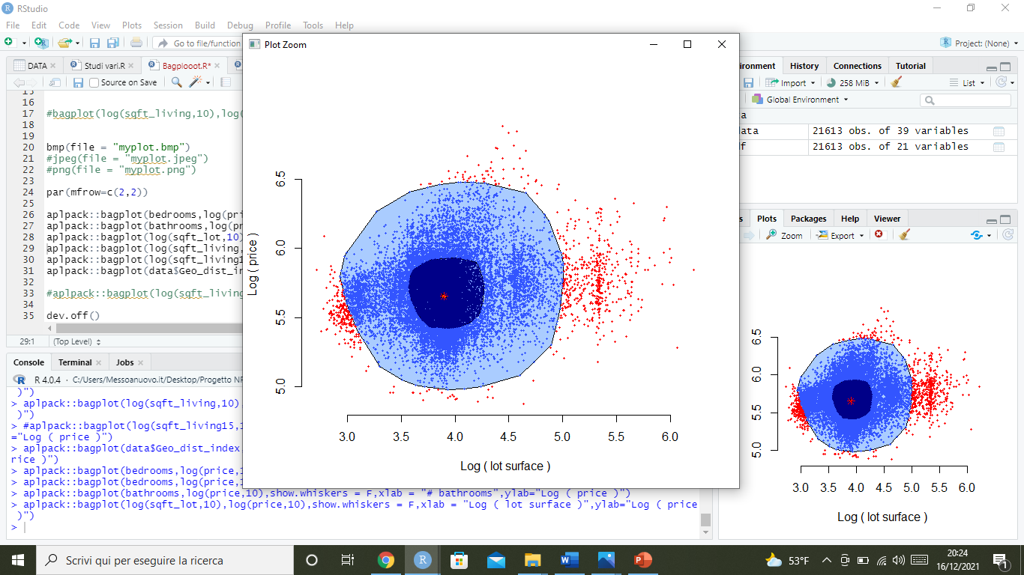
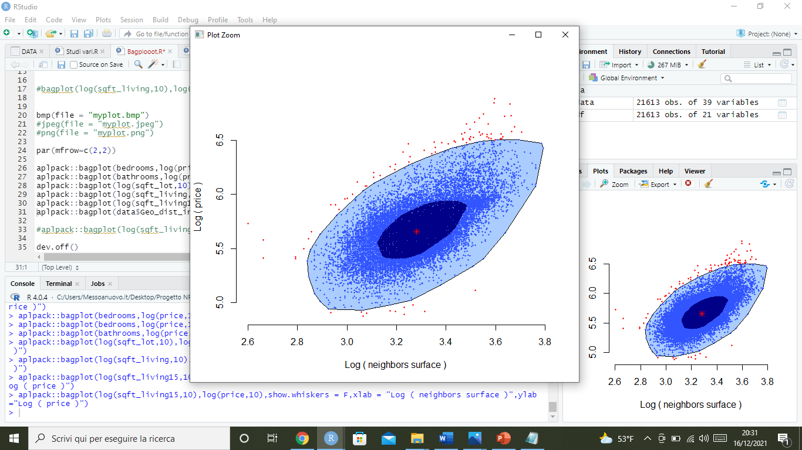
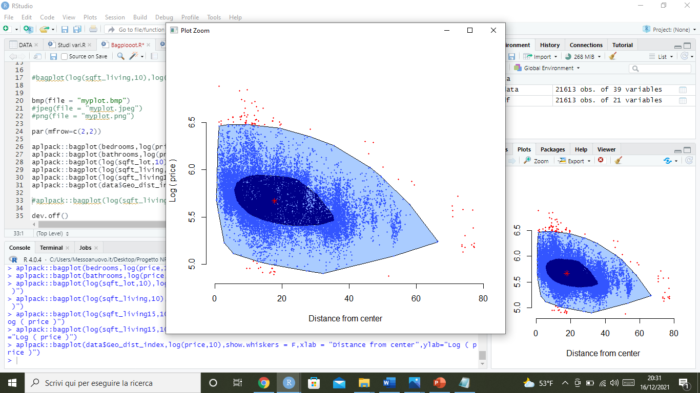
Outlier Detection
Notes:
Aggiungerei da dire che
Abbiamo creato delle altre variabili di interesse quali geodist_index, renovate_index ecc.
Per alcune variabili quali sqm_living, sqm_lot ecc. siamo passate ai log10 avendo un comportamento migliore
Tramite un’esplorazione di tutte le singole covariate abbiamo scelto di considerare queste 6 per l’outlier detection (le altre o apparivano completely useless o restituivano gli stessi outliers di quelle considerate)
Troviamo 1270 outliers che rimuoviamo creando un cleaned dataset

Slide 6
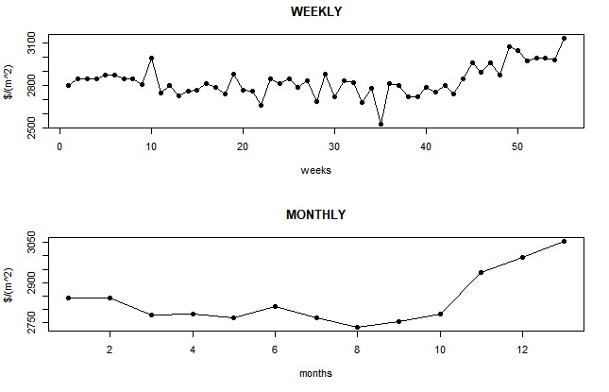
Assumption
Price per square meter in King County May 2014 - May 2015
We assumed that the distribution of the price is stationary
i.e. the price per square meter didn’t change through time

Slide 7
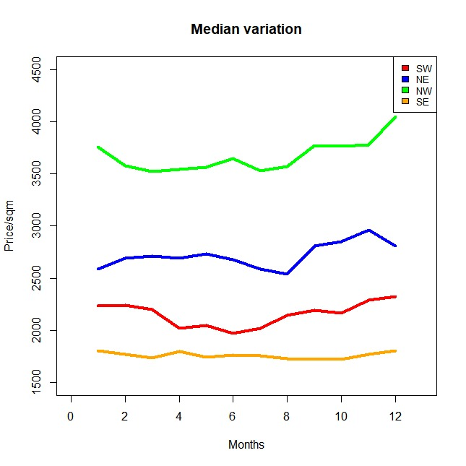
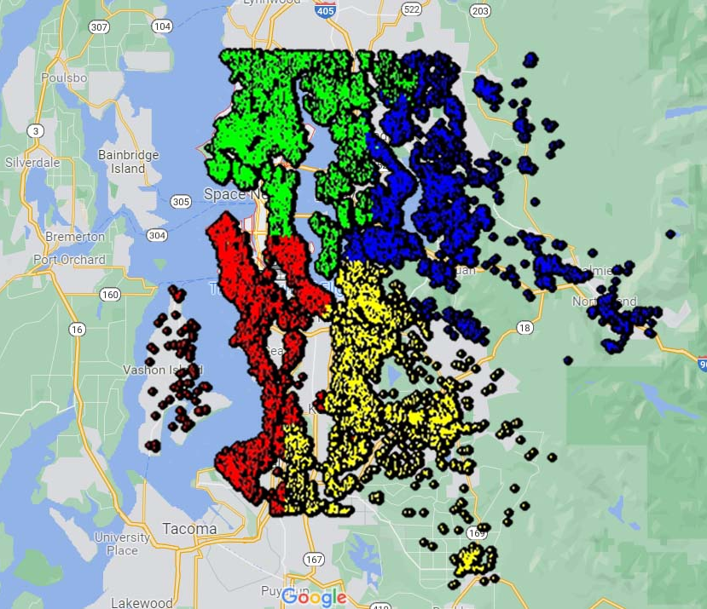
..more on price per square meter
Houses clustered in 4 geographic areas
The price per square meter changes in space!

Slide 8
Testing
Permutational ANOVA
influence of the geographic distance from the Space Needle on the price
effect of living surface on the price
effect of view on the price
effect of condition on the price

Slide 9
Testing
Chi-square test of independence
view and condition are correlated
Permutational tests
the most expensive houses are in the wealthiest neighborhoods
diversity in distribution between old but renovated houses and recently built houses

Slide 10
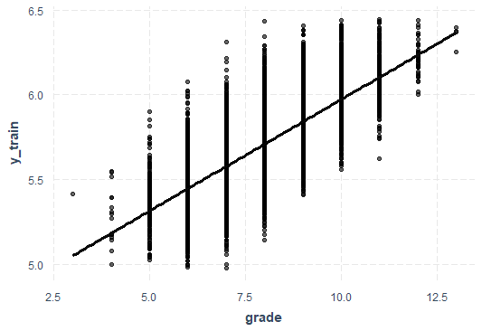
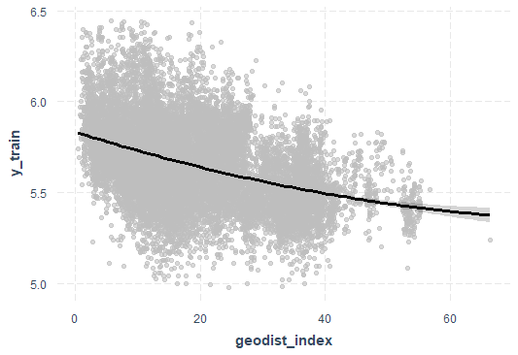
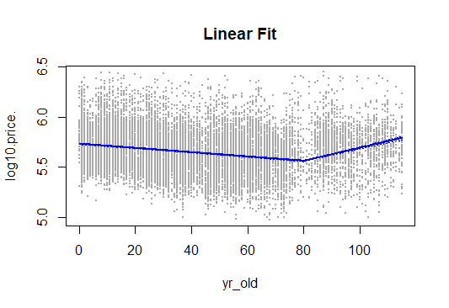
Price model
Nonparametric Robust Regression
Target = Log(price [$])
Features:
Bathfloors_ratio 2-spline
Geodist_index 2-spline
Condition piece-wise linear
Age piece-wise linear
Latitude piecewise-linear
Is_rich
Grade
View
Log(living surface)
Log(lot surface)
Log(neighbors living surface)
Surface upper floor
R^2 = 0.85

Slide 11
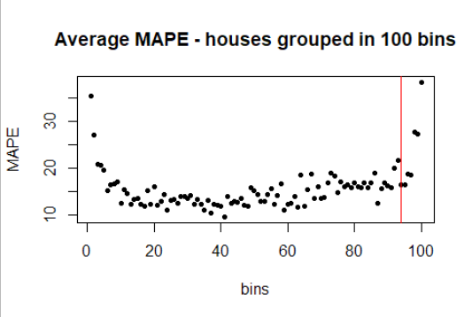
Model improvement
Nonparametric Robust Regression
Average MAPE: 16.05%
Nonparametric Robust Regression – standard houses
Average MAPE: 15.65%
Nonparametric Robust Regression – expensive houses
Average MAPE: 14.25%

Slide 12
Model comparison
Method | MAPE (%) | MAE ($)
Linear Regression | 17.84 | 89.351
Nonparametric Robust Regression | 16.05 | 80.897
Nonparametric Robust Regression (standard + expensive) | 15.56 | 75.436
XGBoost | 11.65 | 58.455
Seattle, WA
State-of-the-art is always better
Nonparametric robust regression outperforms linear models
Model aggregation is an improvement
Notes:
Smoothing splines for both the features and their interactions.

Slide 13
Conclusion
Compiled list of house features that have most significance on the price of sale
The first impression is important
The distance from the main attractions matters
Crafted non-linear relationships of such features on the final price
Compared parametric and nonparametric price models
— The End —

Slide 14
References
[1] Dataset - https://www.kaggle.com/harlfoxem/housesalesprediction
[2] XGBoost - Chen, T., & Guestrin, C. (2016). XGBoost: A Scalable Tree Boosting System. In Proceedings of the 22nd ACM SIGKDD International Conference on Knowledge Discovery and Data Mining (pp. 785–794). New York, NY, USA: ACM.
[3] Data on housing market- https://www.redfin.com/county/118/WA/King-County/housing-market

